Slide 1
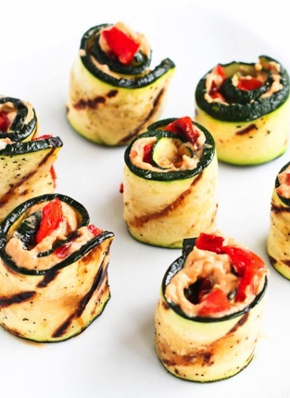
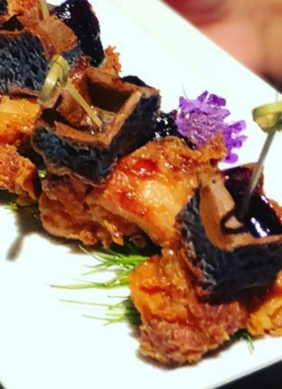
PCS Events
APPETIZER MENU

Slide 2
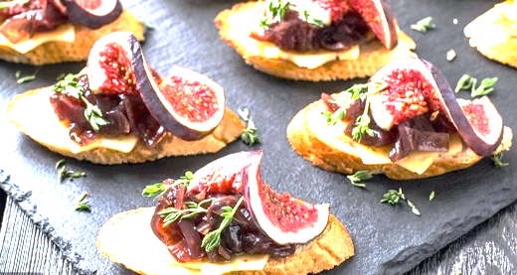
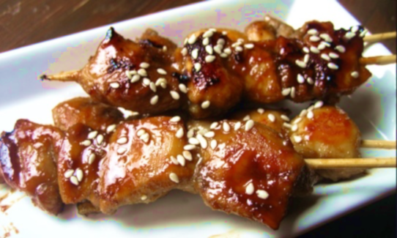
PASSED APPETIZERS Chicken portioned at 1-2 per guest, passed by our friendly staff
Caramelized Honey-balsamic Chicken Bites glazed, grilled and topped with toasted sesame seeds
Japanese-breaded Chicken & Blueberry Waffles with warm lemongrass maple syrup
Buffalo Chicken Bites gorgonzola cream sauce
Spicy Chicken Wonton Flower Thai sesame chicken, crispy Asian slaw, guacamole cream
Hand-pressed Chicken Corn Empanadas Spanish sofrito pulled chicken, Mole verde sauce
Crispy Moroccan Chicken Sliders granny smith apple slaw, lemon dill aioli, jalapenos
Chicken Tikka Masala Satay aromatic curry and cumin, honey-cucumber relish

Slide 3
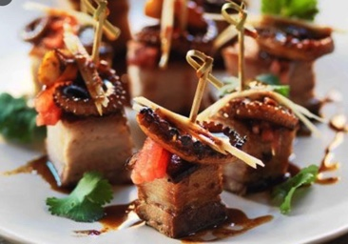
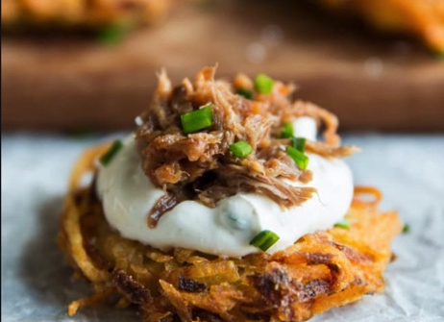
PASSED APPETIZERS Pork
Crispy Asian Pork Belly bites tamarind and chili jam, scallions
Peruvian Pulled Pork Plantain pickled red onion, fresh cilantro and avocado
BBQ Pulled Pork on Sweet Potato Latka smoky mesquite sauce, cumin sour cream
Smokehouse Bacon-wrapped Sweet Plantains guava marmalade drizzle
Manchego & Chorizo Crostini

Slide 4
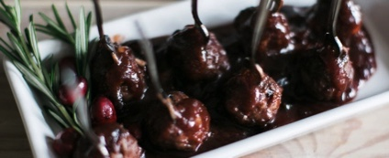
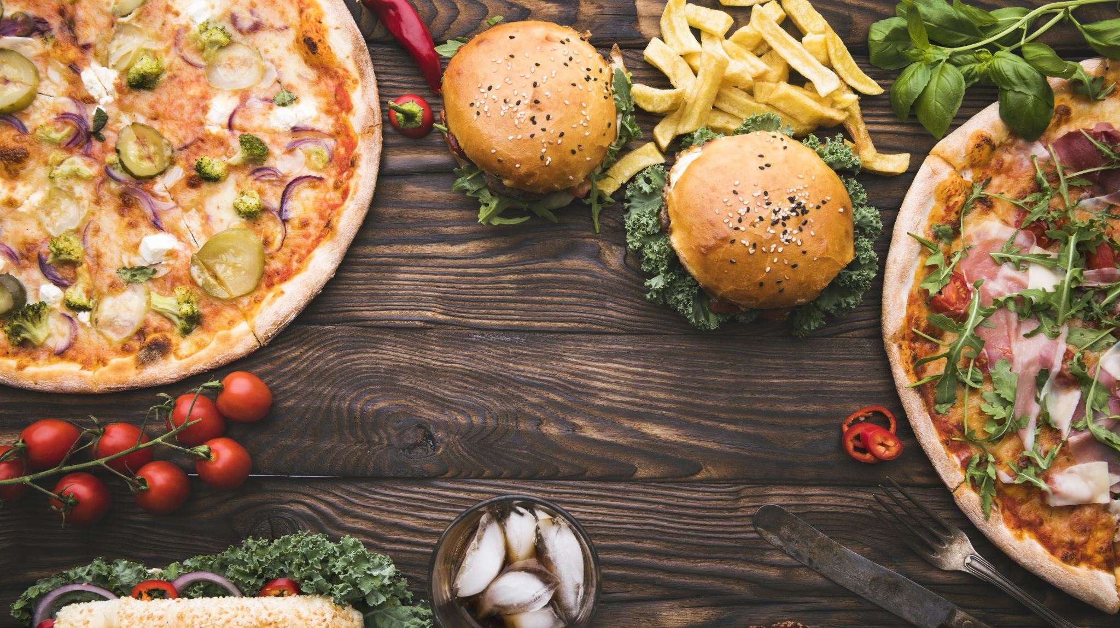
PASSED APPETIZERS Beef
Cabernet Slow-braised Short Rib with beer and white cheddar cheese grits, served on Asian spoon
Mongolian Beef mini skewers toasted black and white sesame seeds, chives
Churrasco steak and Prosciutto skewers creamy basil-tarragon sauce
Slowly-simmered Meatballs siracha honey, bacon bourbon BBQ, garlic roasted-tomato basil or Chinese hoisin ginger sauce
Mini Beef Wellington bearnaise sauce
Hand-pressed Mini Beef & Manchego Empanadas smoky pineapple habanero sauce
Angus Beef Sliders on sesame brioche bun American cheese, caramelized onions, arugula and pink garlic alioli
Caribbean Plantain Cups filled with Spanish-style beef “Ropa Vieja”

Slide 5
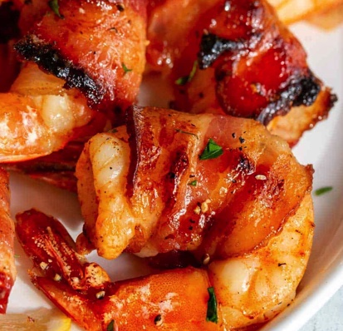
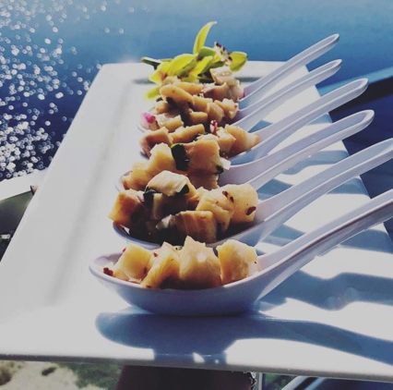
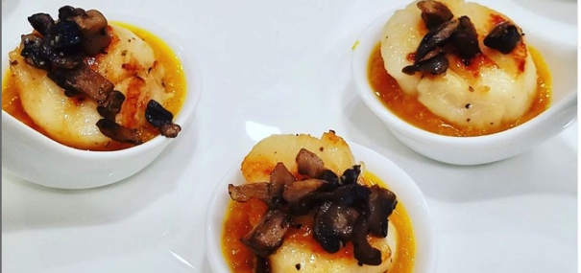
PASSED APPETIZERS Seafood
Grilled Chorizo-wrapped Jumbo Shrimp orange-mango bbq glaze
Peruvian Fish Ceviche fresh cilantro, red onion, citrus juices, yellow pepper cream and toasted corn
Garlic-seared Scallops calabaza cream and portobello mushroom picadillo
Cajun Crab & Shrimp Mac n’ Cheese white cheddar, asiago and parmesan
Vietnamese Shrimp Rolls spicy chili plum sauce
Island Conch Fritters zesty citrus Bahamian cocktail sauce
Crispy Golden Coconut Shrimp orange-pineapple habanero sauce
Mediterranean Grilled Octopus lemon, olive oil, garlic and sea salt
Jumbo Shrimp Cocktail horseradish cocktail sauce
Mini New England Crab Cakes citrus-dijon alioli

Slide 6
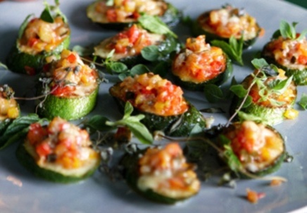
VEGETARIAN & VEGAN APPETIZERS
Buffalo Corn-dusted Baked Cauliflower blue cheese alioli
White Fontina Pizzette topped with sun-dried tomatoes, mushrooms, Vidalia onions and arugula
Grilled Figs stuffed with Montrachet goat cheese and onions, balsamic reduction
Falafel Fritter Sliders cucumber-radish relish, tzatziki sauce
Mexican Mini Arepas corn arepa, guacamole mousse, fresh pico de gallo and sour cream
Sweet Potato Fritters cinnamon-ginger siracha sauce
Caponata Grilled Cheese vegetable caponata, pesto, Manchego cheese on sourdough
Ricotta Arancini di Riso honey drizzle

